Slide 1

CSI: Denver
The Kronos Kidnapping
Courtnay McClure

Slide 2


RESEARCH GOALS
Provide a clear analysis of the structure of the Protectors of Kronos
Describe the events of January 20-21, 2014
Provide two possible explanations as to why the GAStech employees may be missing.
1
2
3

Slide 3


PROVIDED DOCUMENTS
1
Historical Reports Regarding POK
Resumes
Email Headers & Participants
Map of Kronos
Employee Data
Relevant News Reports
2
3
4
5
6

Slide 4

DATA WRANGLING
Employee DataFrame
Employee Resume DataFrame
Email Header DataFrame
Email Interaction Matrix
Historical Document DataFrame
Article List 20th Jan
Article List 21st Jan
1
2
3
4
5
6
7

Slide 5



TOOLS USED
1
2
3
Basics: pandas, os
Text Based: re, docx, nltk, Rake
Visuals: WordCloud, matplotlib, seaborn

Slide 6

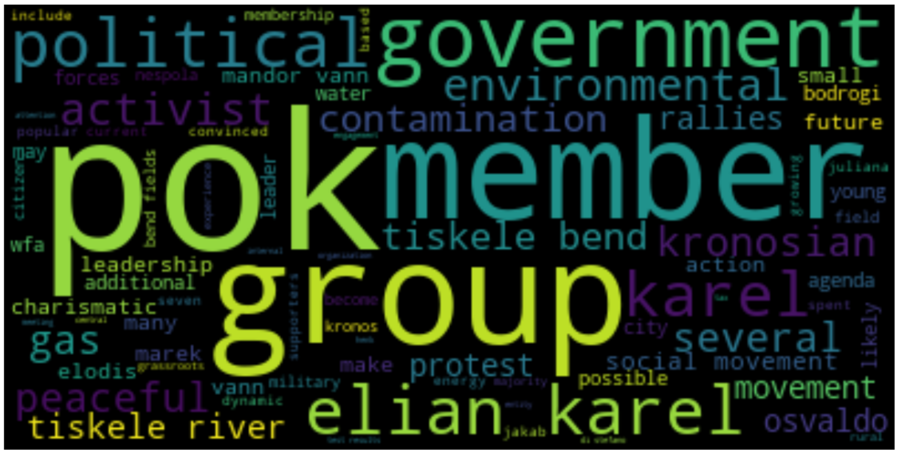
EXPLORATION
Important phrases/words in historical documents
List of names with suspicious characteristics
Email headers sent from suspect list
Resume key words of suspects
1
2
3
4

Slide 7
DATA ANALYSIS
1
2
3
Key Phrases = Structure
Suspicious Characteristics based on phrases + Email interaction = List of suspects
Key Events by keywords = Timeline

Slide 8
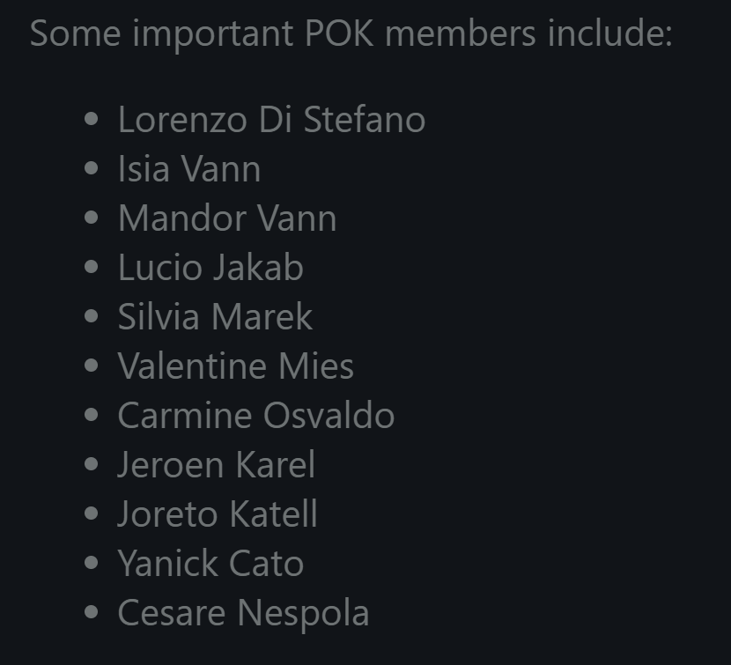
POK STRUCTURE
1
LEADERS: Henk Bodrogi, Elian Karel, and Silvia Marek

Slide 9
POK STRUCTURE
1
2
3
Originally 7 Members
Wanting Stricter Environmental Laws
Headed by Henk Bodrogi
Gained popularity when Juliana Vann was killed due to toxicity pollution tied to GAStech dumping in the river
When the health minister died, Bodrogi stepped down and chose Elian Karel to take his place.
POK started recruiting
Still peaceful but getting involved with more activism and protests
Elian Karel dies, and Silvia Marek takes over.
The organization becomes more militant and criminal.
New members radicalized and become less peaceful. The public takes note.

Slide 10
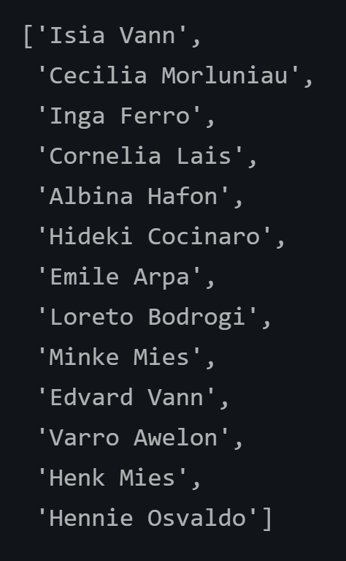
POTENTIAL CONNECTIONS
1
Keywords:
Last Name
Birth Country
Employment Start Date (2009 +)
Security Department

Slide 11
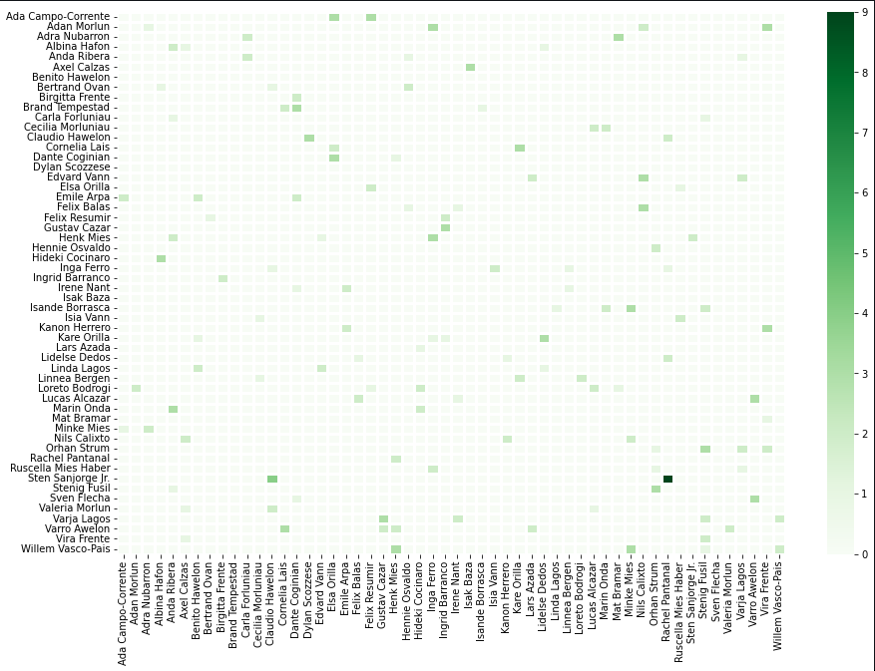
POTENTIAL CONNECTIONS

Slide 12
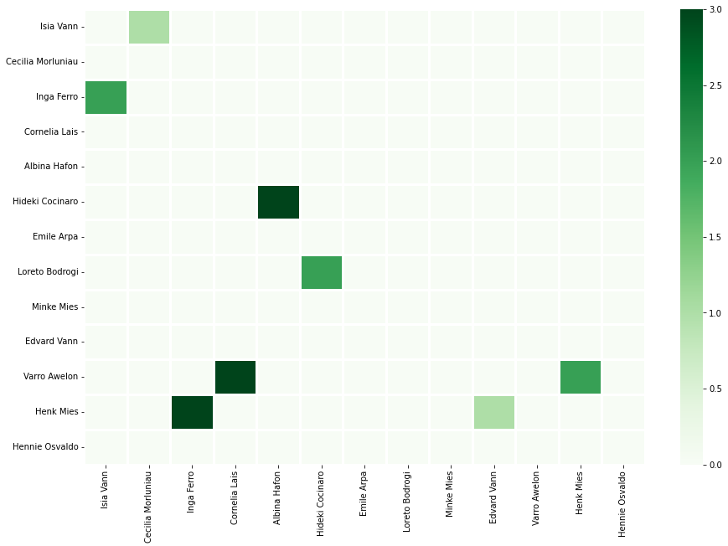

Slide 13
EMAIL CONNECTIONS
Cecilia Morluniau
(Truck Driver)
Isia Vann
(Perimeter Control)
Inga Ferro
(Site Control)
Cornelia Lais
(Assistant To Security Group Manager)
Varro Awelon
(Janitor)
Henk Mies
(Truck Driver)
Hideki Cocinaro
(Site Control)
Loreto Bodrogi
(Site Control)
Albina Hafon
(Truck Driver)
Edvard Vann
(Perimeter Control)

Slide 14
Suspicious Emails
Cecilia Morluniau: 'RE: Facilities preparations for VIP visit’
Loreto Bodrogi: 'RE: Patrol schedule changes’
Edvard Vann: 'Security procedures for January 20 VIP visit’
Isia Vann: 'RE: FW: ARISE - Inspiration for Defenders of Kronos’
Isia Vann: 'RE: Security update: how to handle reporters on the grounds'
1
2
3
4
5

Slide 15
TIMELINE – 20th
10:00 AM
Fire Alarm
10:20 AM
Helicopter leaves during evacuation
10:30
Executives unreachable
10:50 AM – 3:40 PM
Find out fire alarm was pulled due to a bomb threat and several men were spotted wearing black before the alarm was pulled.
5:48 PM
Two private jets took off, one of which included the CEO Sten Sanjorge, Jr.
7:00 PM
Edvard Vann questioned and indicated POK might be involved but denied his own connection
8:00 PM
Police suspect 14 GAStech employees were kidnapped

Slide 16
TIMELINE – 21st
9:00 AM
Police confirm 10 are missing, announcing the CEO was safe in Tethys, his home country
12:45 PM
Protectors of Kronos take responsibility for the kidnapping, demanding $20 Million in ransom from Sanjorge Jr., the CEO

Slide 17
POSSIBLE EXPLANATIONS
After Juliana Vann’s death, while POK gained popularity, not much progress was made policy-wise. GAStech was never held accountable for their actions, and something needed to be done. Isia Vann had been working for GAStech for many years. After 2009, when Elian Karel took over, many POK members got jobs at GAStech to gain control within the company. All suspects worked together to ensure things went according to plan and they kidnapped employees from the ‘invading country’, Tethys. They let CEO, Sten Sanjorge Jr., make it out so that they could demand $20 Million in damages and finally hold GAStech accountable.

Slide 18
POSSIBLE EXPLANATIONS
Isia Vann, while being a longtime member of POK, was fed up with the way the organization was heading. Additionally, GAStech had a large activism group after them for their past mistakes. Working together, the CEO and Isia, along with other security personnel, devised a plan to throw POK under the bus and get them off their backs. The 10 ‘kidnapped’ employees were taken in the helicopter to a safe but unknown place – believing they were kidnapped, while the CEO escaped. Isia, working with POK, convinced them to take responsibility and demand a ransom, as many new radicalized members were out of control. This way, the police would put a firmer grasp on the unmanageable POK members, while letting GAStech pay for past mistakes but manage their reputation.

Slide 19
Thanks For Listening.
Questions?

